Slide 1

AVOID CREATING UNNECESSARY OBJECTS

Slide 2
Why to do it?
Save memory
To improve speed program
Easy inspection and maintenance

Slide 3
How to avoid creating unnecessary objects?
Reuse a single object instead of creating a new functionally equivalent object each time it is needed. An object can always be reused if it is immutable.
You can often avoid creating unnecessary objects by using static factory methods.
You can also reuse mutable objects if you know they won’t be modified

Slide 4
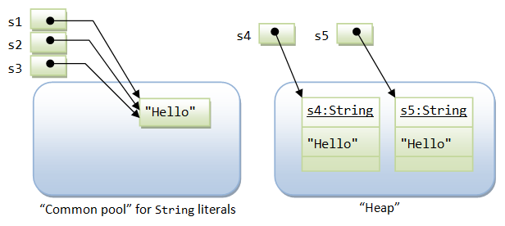
How to avoid creating unnecessary objects?
For example:
+ Ex1: String s4 = new String(“Hello”); // don’t do this
=> String s1 = “Hello”;

Slide 5
How to avoid creating unnecessary objects?
+ Ex2:
class Person1{ private Date birthDate = null public boolean isBabyBoomer(){ Calendar gmtCal = Calendar.getInstance(TimeZone.getTimeZone("GMT")); gmtCal.set(3900, Calendar.JANUARY, 1, 0, 0, 0); Date boomStart = gmtCal.getTime(); gmtCal.set(3920, Calendar.JANUARY, 1, 0, 0, 0); Date boomEnd = gmtCal.getTime(); return (birthDate.compareTo(boomStart) >= 0) && (birthDate.compareTo(boomEnd) < 0); } }

Slide 6
How to avoid creating unnecessary objects?
+ ex3:
class Person2{ private Date birthDate = null; static final Date BOOMSTART; static final Date BOOMEND; static { Calendar gmtCal = Calendar.getInstance(TimeZone.getTimeZone("GMT")); gmtCal.set(3900, Calendar.JANUARY, 1, 0, 0, 0); BOOMSTART = gmtCal.getTime(); gmtCal.set(3920, Calendar.JANUARY, 1, 0, 0, 0); BOOMEND = gmtCal.getTime(); } public boolean isBabyBoomer(){ return (birthDate.compareTo(BOOMSTART) >= 0) && (birthDate.compareTo(BOOMEND) < 0); } }

Slide 7
How to avoid creating unnecessary objects?
Priority use primitive data types for the variables
public static void main(String[] args) {
Long sum = 0L;
for (long i = 0; i < Integer.MAX_VALUE; i++) {
sum += i;
}
System.out.println(sum);
}

Slide 8
public class StringIntern { public static void main(String[] args) { String s1 = "test"; String s2 = "test"; checkEquality(s1, s2); String s3 = new String("test"); String s4 = new String("test"); checkEquality(s3, s4); } public static void checkEquality(String s1, String s2) { System.out.println(System.identityHashCode(s1)); System.out.println(System.identityHashCode(s2)); System.out.println(s1.equals(s2)); System.out.println(s1 == s2); } }
http://kulferhat.blogspot.com/2014/08/ej-5-avoid-creating-unnecessary-object.html

